Slide 1

Explaining Black Box Models-Ensemble and Deep Learning using LIME and SHAP

Slide 2
Revisiting Problem Statement
Anti-money laundering analysts and BSA officers employed by banks must be able to explain and defend their decisions to either escalate or ignore alerts about potential criminal activity.
This is tedious to do manually but generating a high level of explainability with AI and machine learning models is currently difficult.
A variety of reasons, like lack of data, imbalanced datasets, biased datasets etc. can impact the decision rendered by the learning models. Models are gaining traction for explainability. Financial institutions and law agencies, for example demand explanations and evidences (SR 11–7 and The FUTURE of AI Act) bolstering the output of these learning models.
So, how we explain these complex black box models?

Slide 3
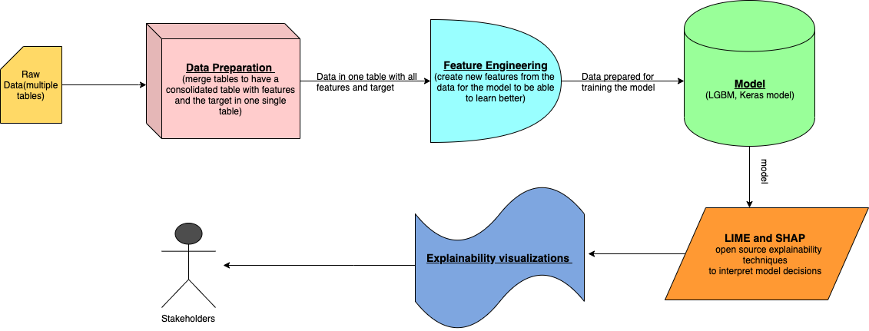
Technical Architecture Diagram
In production, we can use the following architecture to share model explainability with the stakeholders.

Slide 4
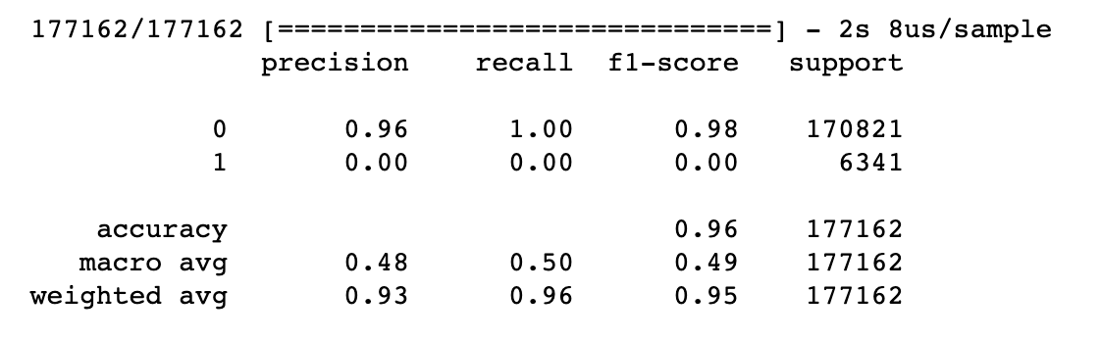
Data Preparation and Modeling
We have used provided IEEE CIS dataset for this work. This dataset consists of 590406 transactions with 435 columns. The target Boolean label is ‘isFraud’.
Post feature engineering, we transformed it to 244 columns.
Following are the classification reports for the Ensemble Learning and Deep Learning models.
LightGBM classification report
Keras classification report

Slide 5
Feature Importance in LightGBM
Before we explore the state of the art explainability techniques, why not explore the feature importance api of LightGBM to understand the top 20 determinants of model decision.

Slide 6
Explainability Techniques
We are going to demonstrate explainability on the decisions made by LightGBM and Keras models in classifying a transaction for fraudulence on the IEEE CIS dataset using LIME (https://github.com/marcotcr/lime) and SHAP (https://github.com/slundberg/shap) from these research papers (1, 2).
We have saved another great open source explainability technique — AIX360 (https://github.com/IBM/AIX360) for later as it proposes 8 novel algorithms by itself for explainability.

Slide 7
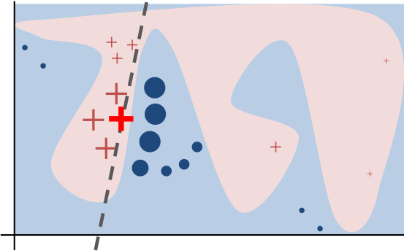
LIME Technique
Intuitively, an explanation is a local linear approximation of the model’s behavior. While the model may be very complex globally, it is easier to approximate it around the vicinity of a particular instance. While treating the model as a black box, LIME perturbs the instance desired to explain and learn a sparse linear model around it, as an explanation.
The figure above illustrates the intuition for this procedure. The model’s decision function is represented
by the blue/pink background, and is clearly nonlinear. The bright red cross is the instance being explained
(let’s call it X). We sample instances around X, and weight them according to their proximity to X (weight
here is indicated by size). We then learn a linear model (dashed line) that approximates the model well in
the vicinity of X, but not necessarily globally. For more information, read this paper, or take a look at
this blog post (https://github.com/marcotcr/lime).

Slide 8
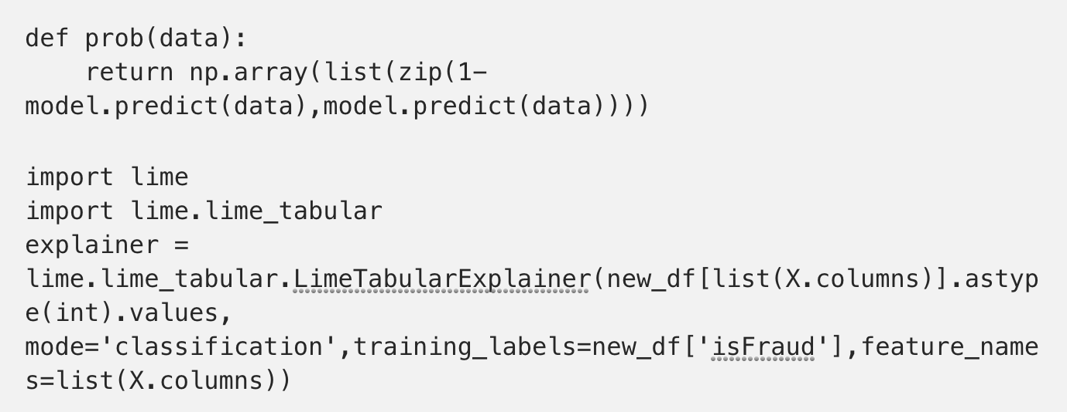
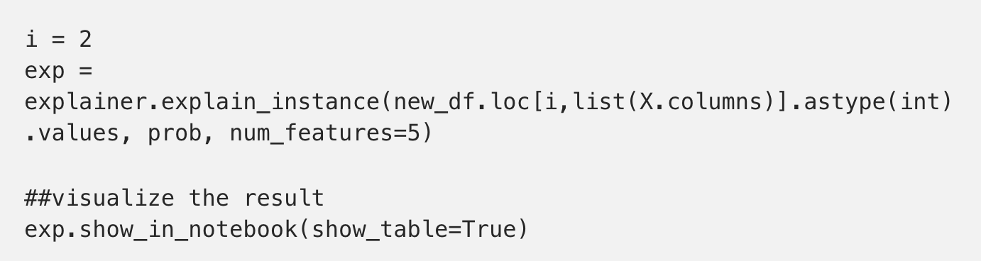
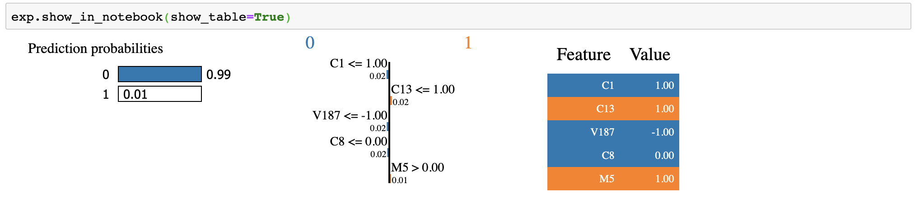
LIME Explainability on LightGBM Predictions
Using this explainer to explain any random instance as follows.

Slide 9
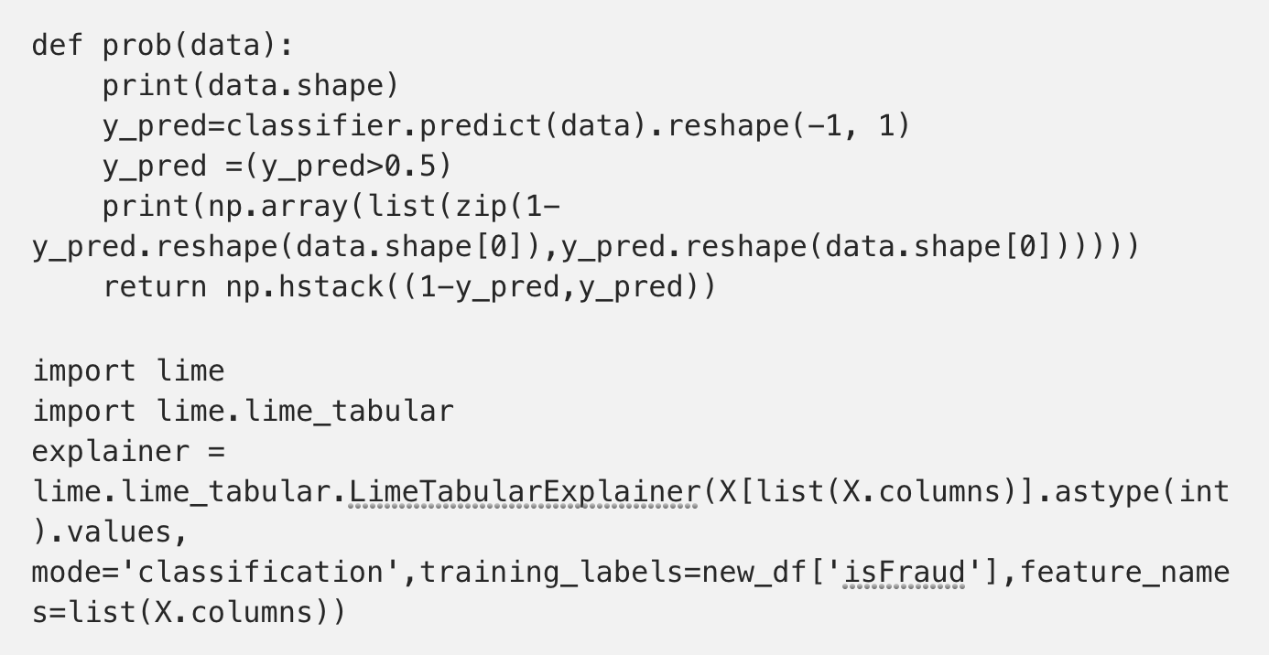
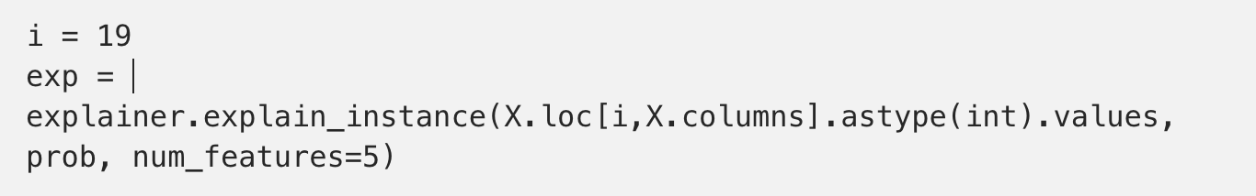
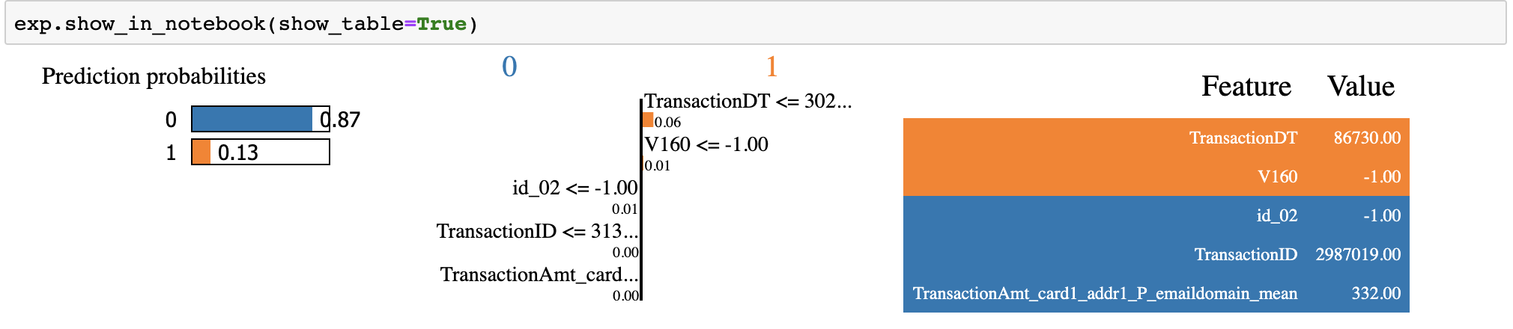
LIME Explainability on Keras Predictions
Using this explainer to explain any random instance as follows.

Slide 10
SHAP (SHapley Additive exPlanations)
The beauty of SHAP (SHapley Additive exPlanations) lies in the fact that it unifies all available frameworks for interpreting predictions. SHAP assigns each feature an importance value for a particular prediction. Its novel components include:
the identification of a new class of additive feature importance measures, and
theoretical results showing there is a unique solution in this class with a set of desirable properties. The new class unifies six existing methods, notable because several recent methods in the class lack the proposed desirable properties. Based on insights from this unification, it presents new methods that show improved computational performance and/or better consistency with human intuition than previous approaches.

Slide 11
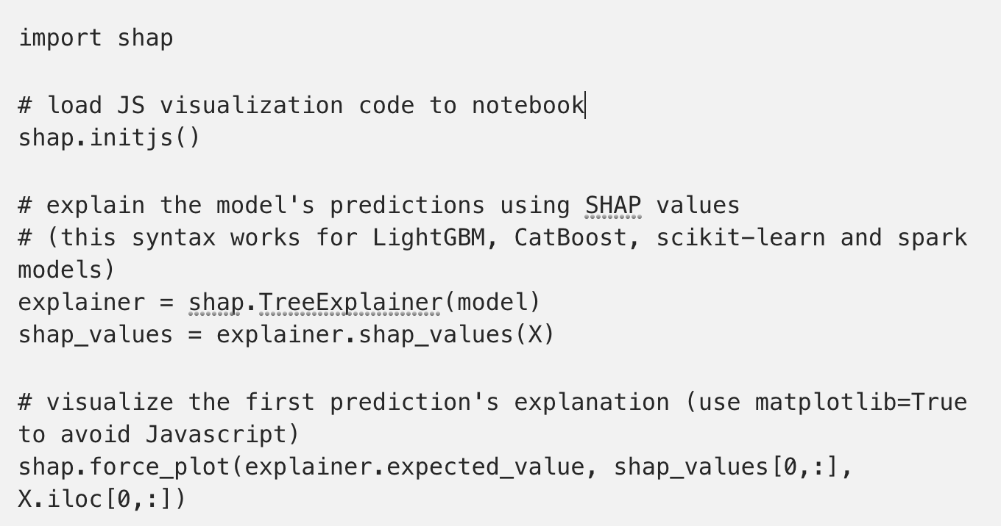
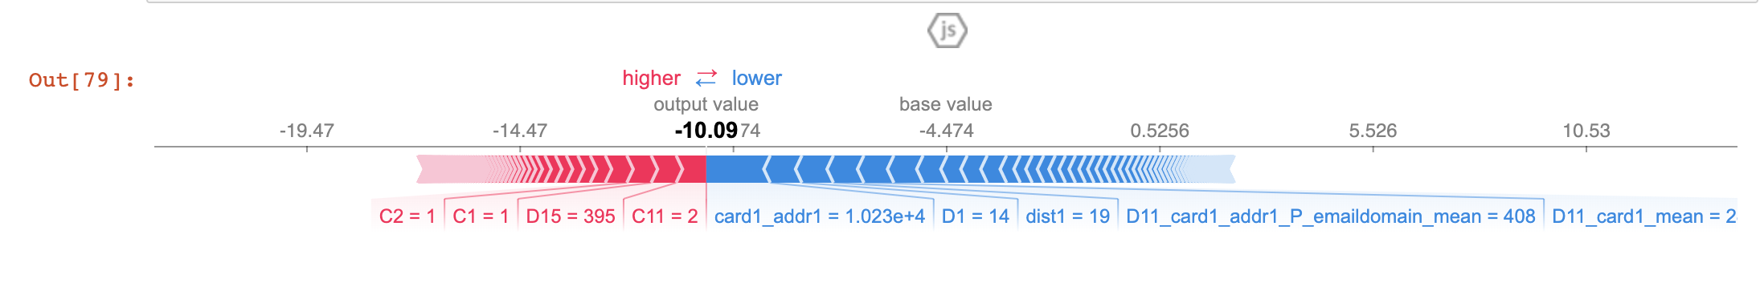
SHAP Explainability on LightGBM Predictions
The above explanation shows features each contributing to push the model output from the base value (the average model output over the training dataset we passed) to the model output. Features pushing the prediction higher are shown in red, those pushing the prediction lower are in blue (these force plots were introduced in the Nature BME paper). If we take many explanations such as the one shown above, rotate them 90 degrees, and then stack them horizontally, we can see explanations for an entire dataset .
The above explanation shows features each contributing to push the model output from the base value (the average model output over the training dataset we
passed) to the model output. Features pushing the prediction higher are shown in red, those pushing the prediction lower are in blue (these force plots were
introduced in the Nature BME paper). If we take many explanations such as the one shown above, rotate them 90 degrees, and then stack them horizontally,
we can see explanations for an entire dataset .

Slide 12
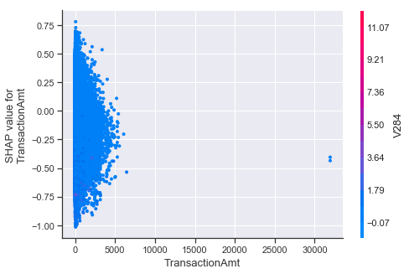
SHAP Explainability on LightGBM Predictions
To understand how a single feature affects the output of the model we can plot the SHAP value of that feature vs. the value of the feature for all the examples in a dataset. Since
SHAP values represent a feature’s responsibility for a change in the model output, the plot below represents the change in predicted house price as TransactionAmt (the amount
in the transaction) changes. Vertical dispersion at a single value of TransactionAmt represents interaction effects with other features. To help reveal these interactions
dependence_plot automatically selects another feature for coloring. In this case coloring by V284 highlights that the average number of TransactionAmt has less impact on fraud probability for
cases with a high V284 value.

Slide 13
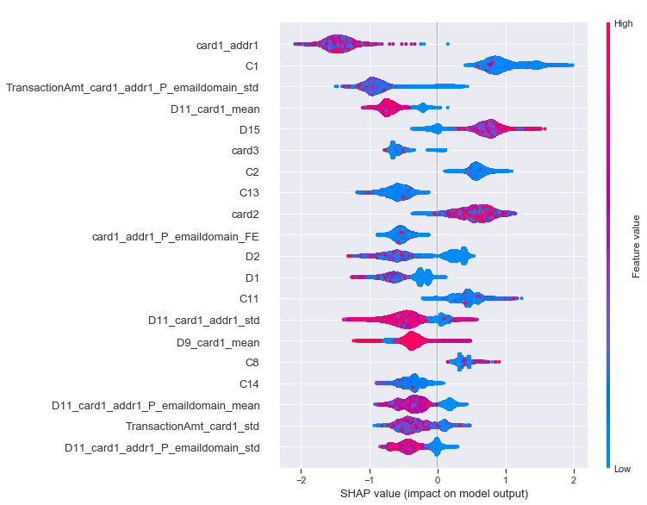
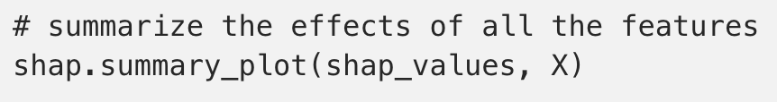
SHAP Explainability on LightGBM Predictions
To get an overview of which features are most important for a model, we can plot the SHAP values of every feature for every sample. The plot below sorts features by the sum of SHAP value magnitudes over all samples and uses SHAP values to show the distribution of the impacts each feature has on the model output. The color represents the feature value (red high, blue low). This reveals for example that a card holder address has a high impact on its predicted fraudulent status.

Slide 14
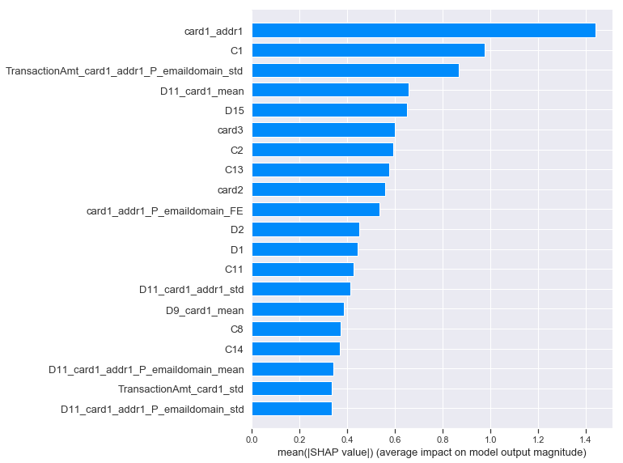
SHAP Explainability on LightGBM Predictions
We can also just take the mean absolute value of the SHAP values for each feature to get a standard bar plot

Slide 15
SHAP Explainability on Keras Predictions
Features pushing the prediction higher are shown in red, those pushing the prediction lower are in blue (these force plots are introduced in the Nature BME paper).

Slide 16
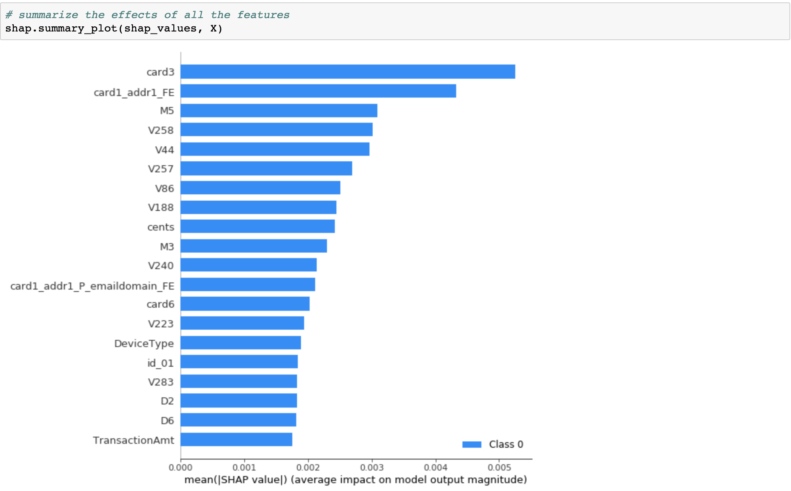
SHAP Explainability on Keras Predictions
We can also just take the mean absolute value of the SHAP values for each feature to get a standard bar plot

Slide 17
Differences between SHAP and LIME
LIME creates a surrogate model locally around the unit who’s prediction you wish to understand. Thus it is inherently local.
Shapely values ‘decompose’ the final prediction into the contribution of each attribute — this is what some mean by ‘consistent’ (the values add up to the actual prediction of the true model, this is not something you get with LIME).
So Shapely actually tells you, in an additive way, how you got your score, but there is some choice about the ‘starting point’ (i.e. the decision about omitted attributes).

Slide 18
Relevant Research Work
Distilling a Neural Network Into a Soft DecisionTree
EXPLAINABLE ARTIFICIAL INTELLIGENCE: UNDERSTANDING, VISUALIZING AND INTERPRETING DEEP LEARNING MODELS
Increasing the Interpretability of Recurrent Neural Networks Using Hidden Markov Models
Iterative Orthogonal Feature Projection for Diagnosing Bias in Black-Box Models
A Unified Approach to Interpreting Model

Slide 19
Thank You
Our code can be accessed at - https://github.ibm.com/Shilpi Bhattacharyya/explainable_deep_learning
Our blog can be found at - https://towardsdatascience.com/explaining-black-box-models-ensemble-and-deep-learning-using-lime-and-shap-53c59d9f09b3?

